Slide 1
World’s Best Ear Trainer
By Ryan Morrison

Slide 2
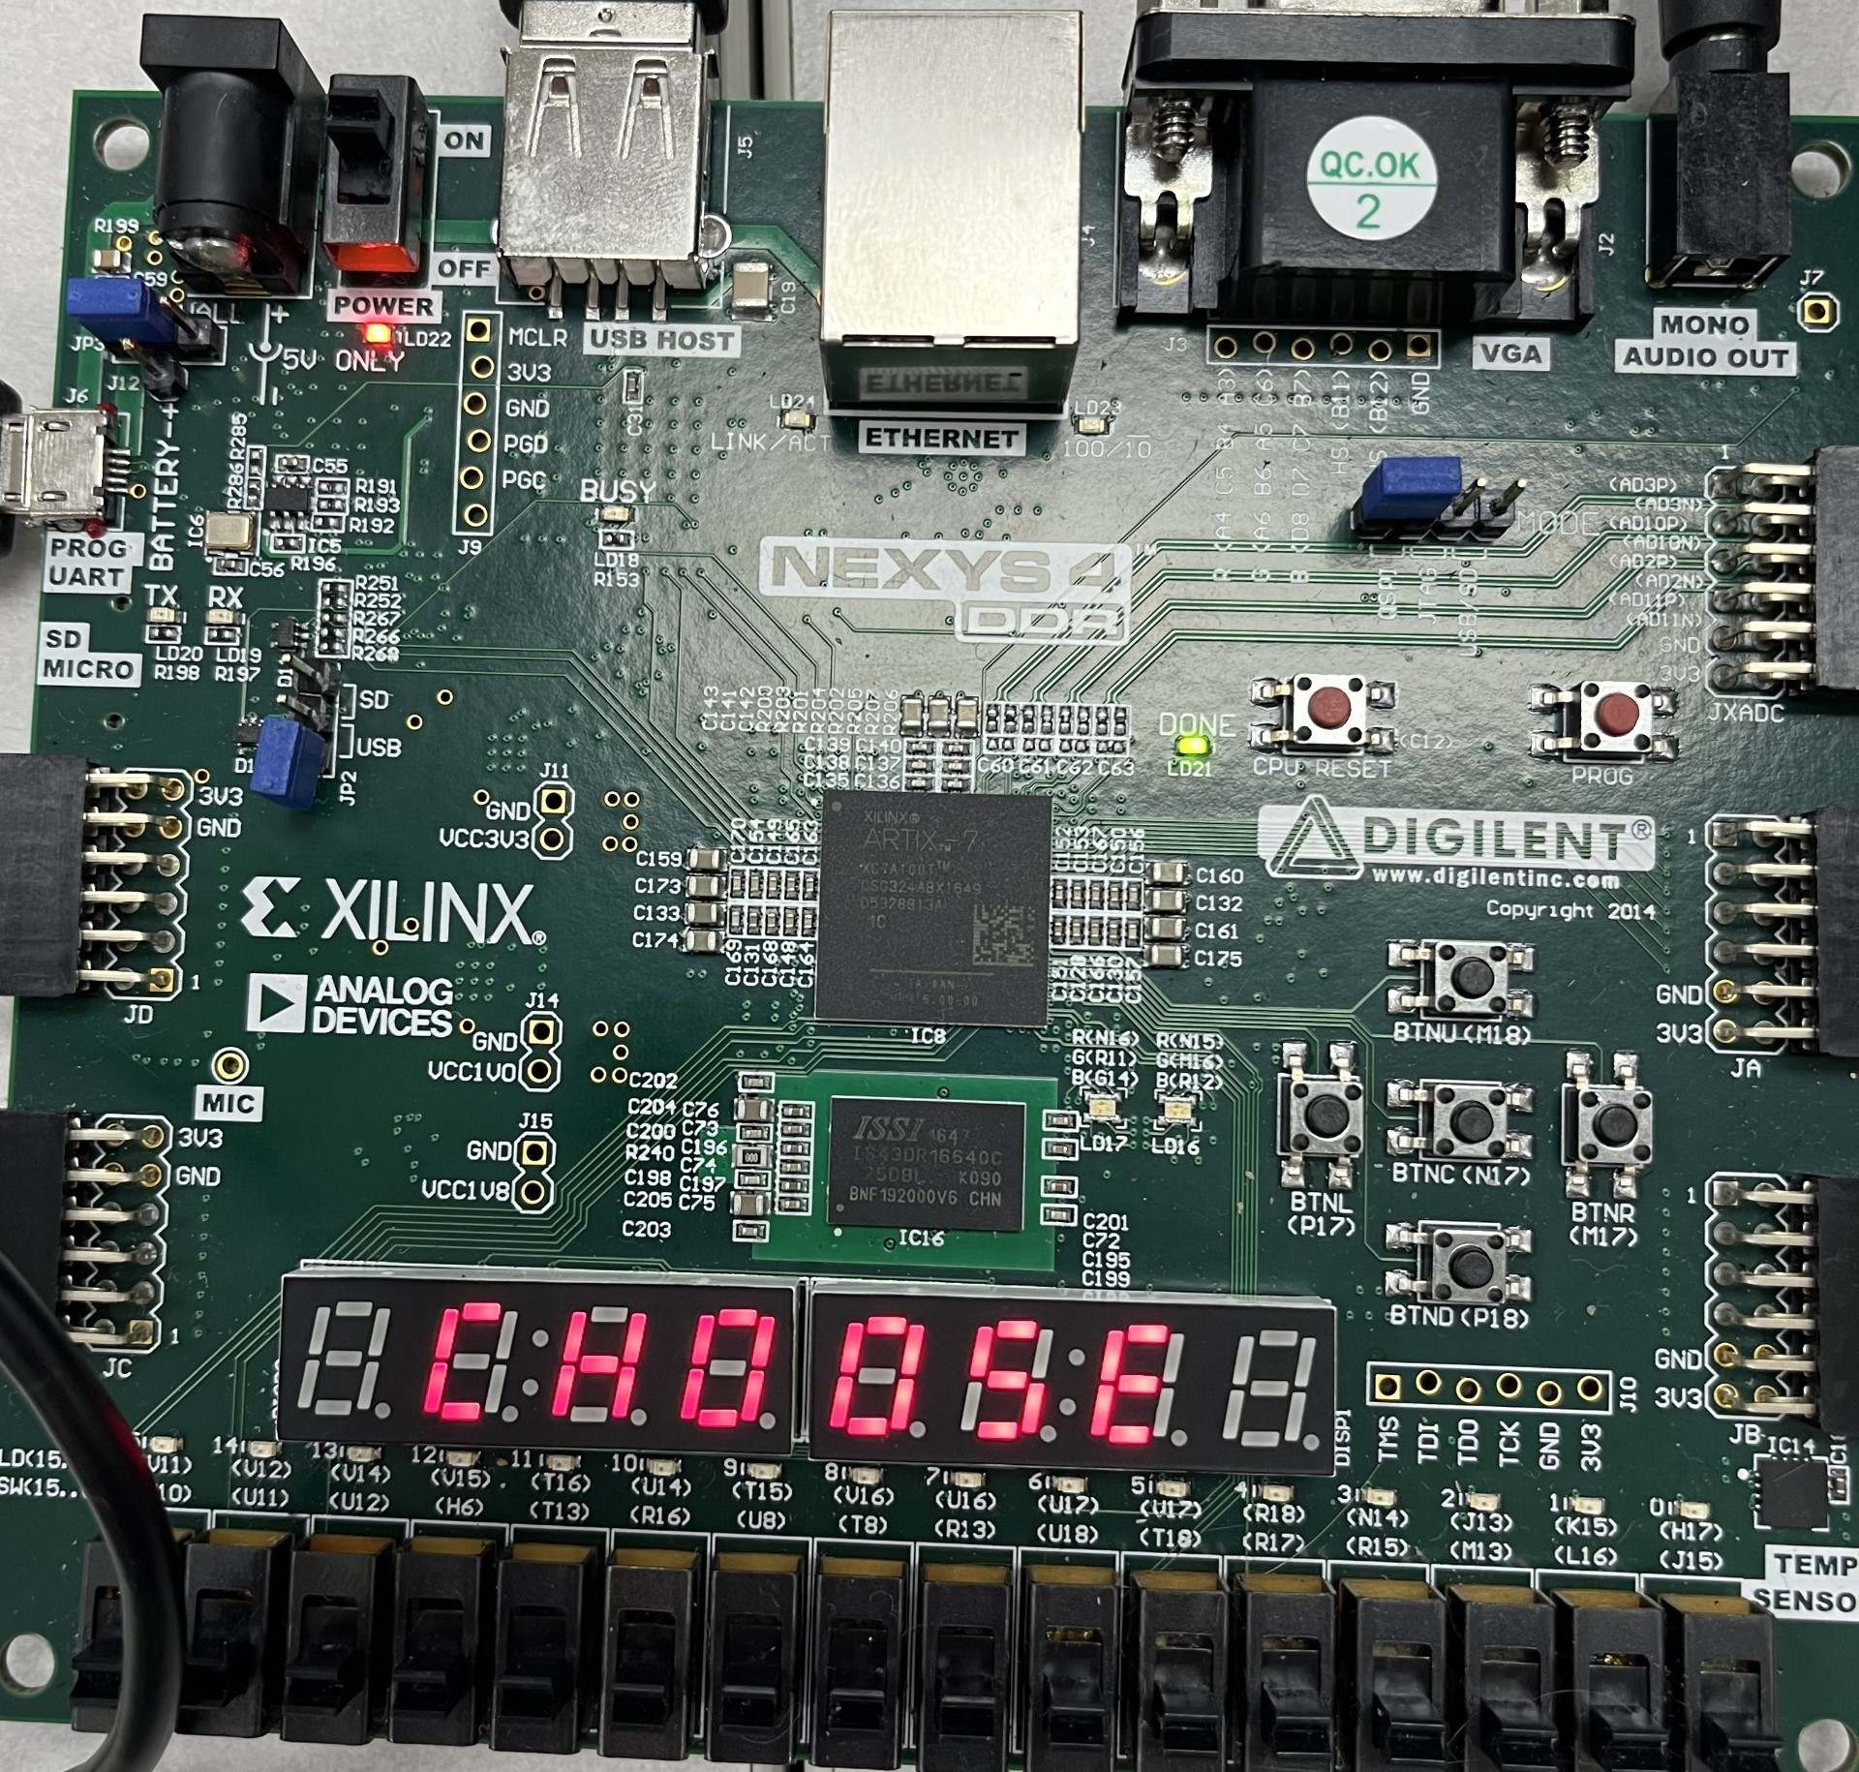
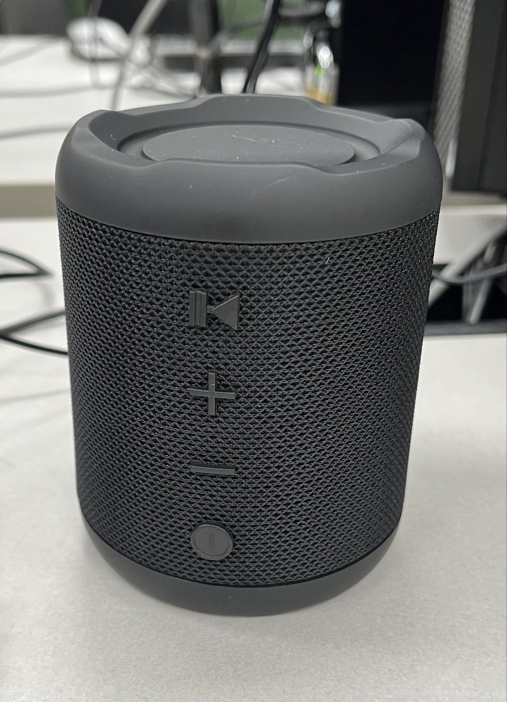
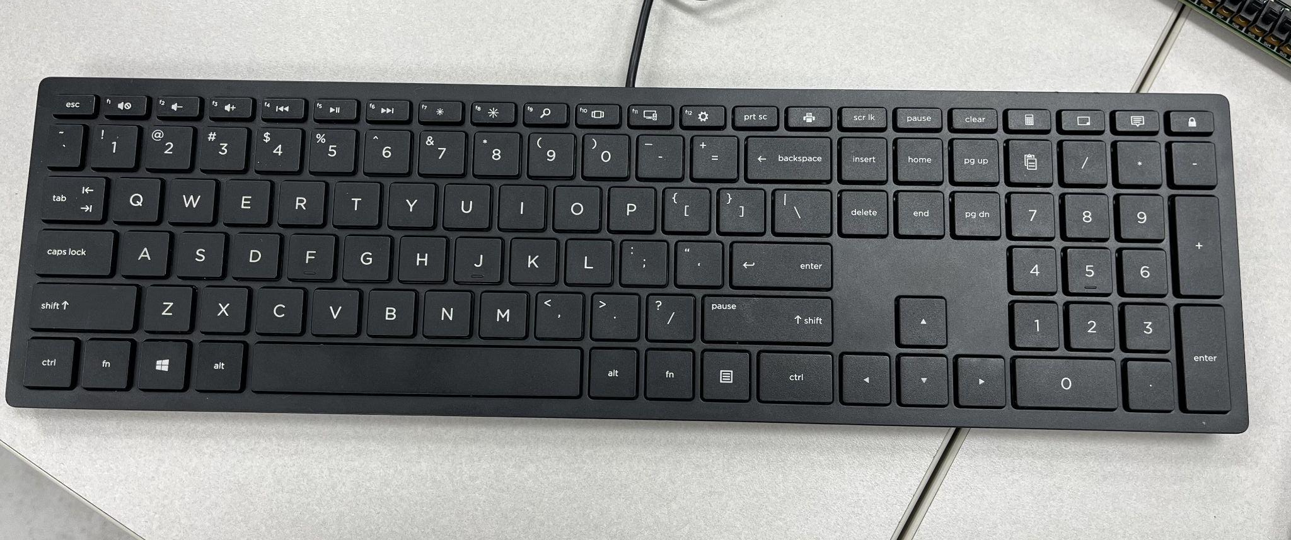
Hardware
Nexys4 Board
Portable Speaker
Keyboard

Slide 3
Chu’s Software
SsegCore
Ps2Core
DdfsCore

Slide 4
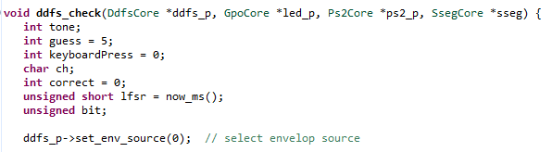
The Code Pt. 1
Pass in the necessary cores from Chu
Declare relevant variables
Use the now_ms() function for pseudo-randomness
Setup DdfsCore

Slide 5
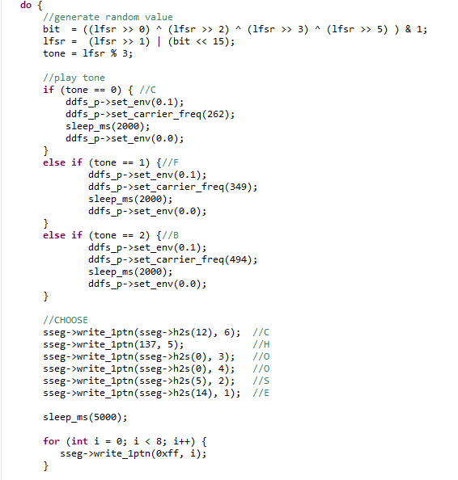
The Code Pt. 2
Generate random value via a linear feedback shift register
Play tone based off of random value
Prompt user to select a note using the keyboard

Slide 6
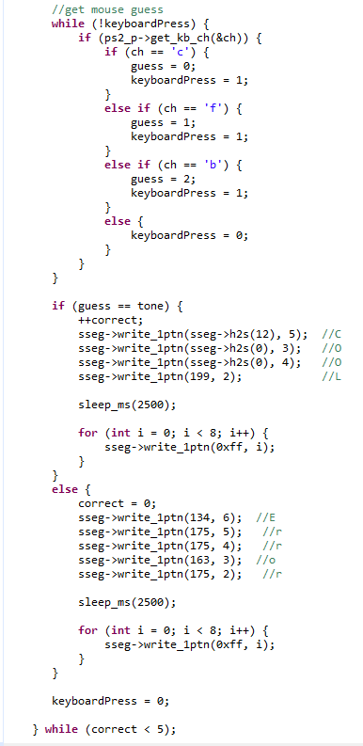
The Code Pt. 3
Wait for user to press a button on the keyboard
Save the user’s guess
Compare user’s guess to tone
If correct, increment counter
If wrong, reset counter
Let user know if they were right or wrong
Loop until user gets 5 notes correct in a row

Slide 7
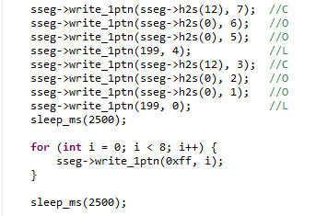
The Code Pt. 4
Congratulate player on winning!

Slide 8
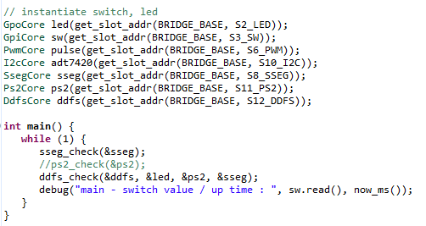
The Code Pt. 5
Instantiate necessary cores from Chu
Call sseg_check to clear display
Call ddfs_check function
Loop in main, so game immediately starts again when player wins.

Slide 9

Let’s see it in action!

